Slide 1
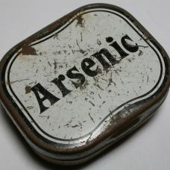
Team “Arsenic” Project – “Battle-Field-1”
Team Members:
Yana
Ilian
Galin

Slide 2
Workflow
Introduced 4 new classes to logically separate the given code from both classes Methods & BattleFieldGame:
Engine
ExplosionGenerator
Renderer
ConsoleInput

Slide 3
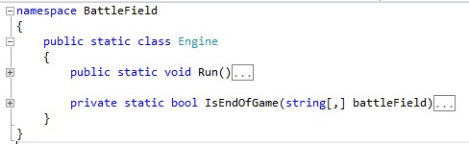
Workflow
static class Engine contains:
Run() – extracted from vremeEIgrachaDaDeistva(), controls the lifecycle of the game
IsEndOfGame() – renamed from Krai()

Slide 4
Workflow
class ExplosionGenerator contains:
Detonate() – extracted from vremeEIgrachaDaDeistva, controls the lifecycle of the game
5 Refactored Methods from: HitOne, PrasniDvama, HitThree, HitFour, HitFive. Also called with proper names. A few magic numbers removed and added enumeration for MineTypes.

Slide 5
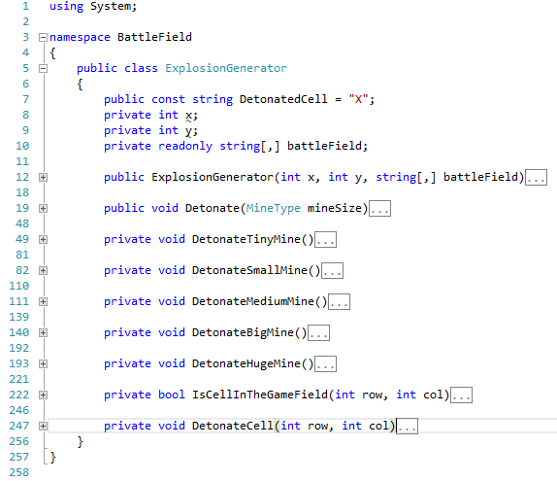

Slide 6
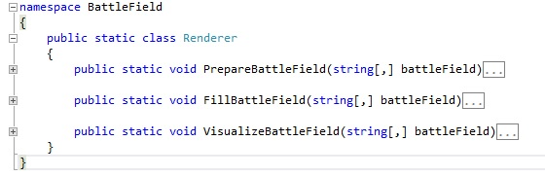
Workflow
class Renderer contains:
PrepareBattleField() – extracted from Main()
FillBattleField() – refacored from AddBombs()
VisualizeBattleField() – draws the game.

Slide 7
Workflow
class ConsoleInput contains:
TakeSizeOfBattleField() – extracted from Main()
ReadPlayerMove() – loops until correct input is entered (extracted from vremeEIgrachaDaDeistva())
TryParseValidUserInput() – checks for valid format of the data. (extracted from vremeEIgrachaDaDeistva())
IsInputValidCoordinate() – checks if the data is valid coordinate. (extracted from vremeEIgrachaDaDeistva())
IsPlayerValidMove() – checks if the data is valid game movement. (extracted from vremeEIgrachaDaDeistva())

Slide 8
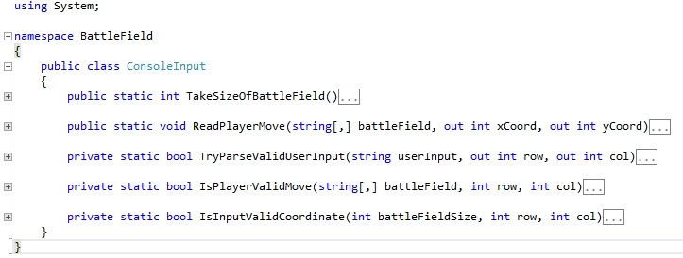

Slide 9
Code
Demo & Unit Tests

Slide 10
Resources & Links
Repository:
https://github.com/ilian-ivanov/TeamWorkArsenic/
Log:
https://github.com/ilian-ivanov/TeamWorkArsenic/commits/master

